Slide 1
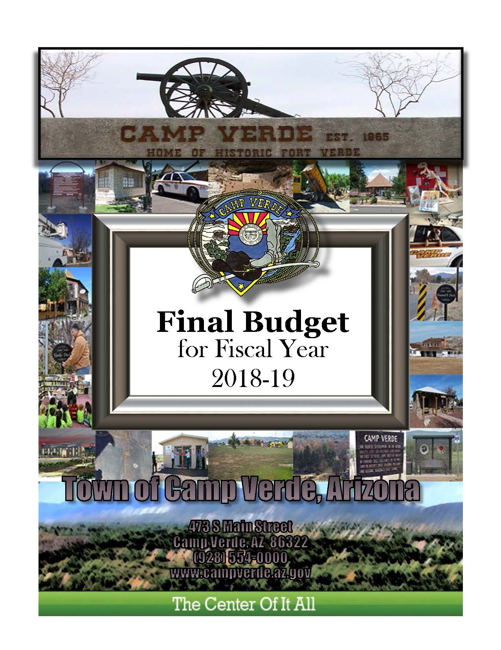
Town of Camp Verde
The Center Of It All
Annual
Budget
Process

Slide 2
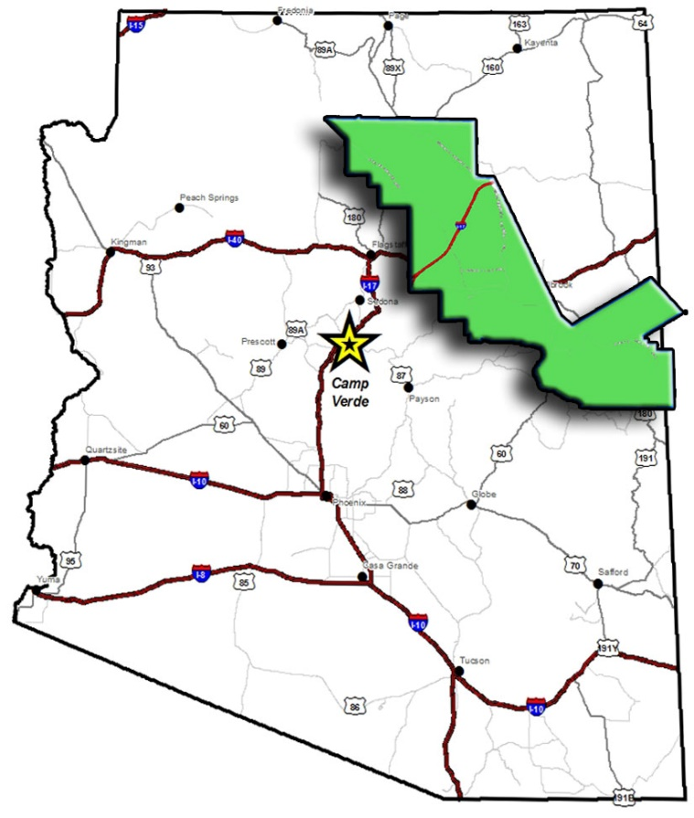
Population: 11,000 Square miles: 42.6 Stoplights: 7*
GF Exp: $8.6M
Finance Ee’s: 3
World’s Largest Kokopelli: 1

Slide 4
CIP
Budget Animal Farm
Fees
Operations
Strategic
Plan
Wages
Other
SRF
Debt

Slide 5
Budget Time Line

Slide 6
Strategic Plan
– the Kitty Cat

Slide 7
Strategic Plan
Homework
Intro / Review
Values
State of the Town
SWOT Analysis
Goals

Slide 8
Strategic Plan
Homework
Intro / Review
Values
State of the Town
SWOT Analysis
Goals

Slide 10
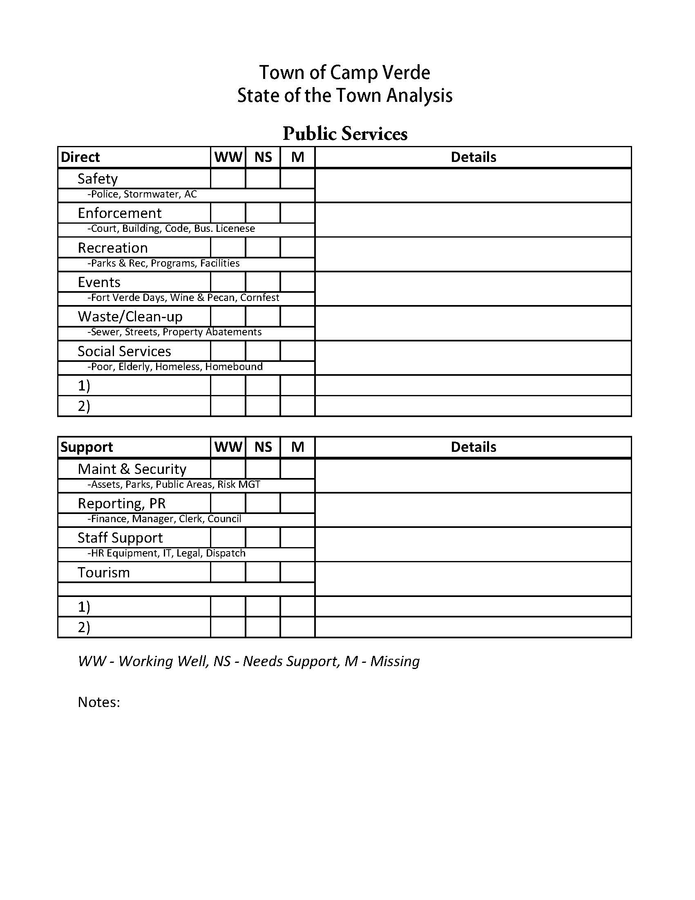

Slide 11
Strategic Plan
Homework
Intro / Review
Values
State of the Town
SWOT Analysis
Goals

Slide 12
Strategic Plan
Homework
Intro / Review
Values
State of the Town
SWOT Analysis
Goals

Slide 14
Strategic Plan
Homework
Intro / Review
Values
State of the Town
SWOT Analysis
Goals

Slide 15
Strategic Plan
Homework
Intro / Review
Values
State of the Town
SWOT Analysis
Goals

Slide 19
Strategic Plan
Homework
Intro / Review
Values
State of the Town
SWOT Analysis
Goals

Slide 20
Strategic Plan
Expand public services infrastructure.
In the short-term, wastewater services need to be expanded to allow for future economic growth. In the long-term, securing right-of-way areas and water delivery services.

Slide 22
Capital improvement Plan
I want it NOW!
– the Pig

Slide 23
Capital improvement Plan
Projects Sheets
Presentations
Discussion & Ranking
Development
Reviews
Approval

Slide 24
Capital improvement Plan
Projects Sheets
Presentations
Discussion & Ranking
Development
Reviews
Approval

Slide 26
Capital improvement Plan
Projects Sheets
Presentations
Discussion & Ranking
Development
Reviews
Approval

Slide 27
Capital improvement Plan
Projects Sheets
Presentations
Discussion & Ranking
Development
Reviews
Approval

Slide 28
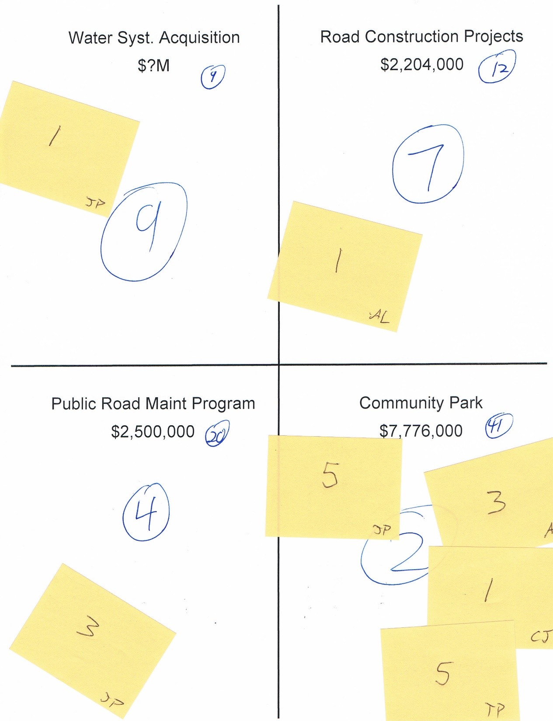

Slide 30
Capital improvement Plan
Projects Sheets
Presentations
Discussion & Ranking
Development
Reviews
Approval

Slide 32
Capital improvement Plan
Projects Sheets
Presentations
Discussion & Ranking
Development
Reviews
Approval

Slide 33
Capital improvement Plan
Projects Sheets
Presentations
Discussion & Ranking
Development
Reviews
Approval

Slide 34
Operations
General Fund
HURF/Streets
Wastewater
CIP
Debt Snapshot
– the Puppy

Slide 35
Operations
Revenues
Wages
Fees

Slide 36
Operations
Revenues
-State Taxes
-Local Taxes
-CIP Est’d Funding
Wages
Fees

Slide 37
Operations
Revenues
Wages
Fees

Slide 39
Operations
Revenues
Wages
Fees

Slide 40
Operations
Expenses
Dept Heads enter expenses into software
Pull exp’s into Excel
Manager review’s with Dept Heads
Council presentations
Council reviews with Town Manager & Finance Director
Final prep for Tentative Budget approval

Slide 42
Operations
Expenses
Dept Heads enter expenses into software
Pull exp’s into Excel
Manager review’s with Dept Heads
Council presentations
Council reviews with Town Manager & Finance Director
Final prep for Tentative Budget approval

Slide 43
Town of Camp Verde
The Center Of It All
Mike Showers
Finance Director
Michael.Showers@CampVerde.az.gov
928.554.0811

