Slide 1
Impact of the American Rescue Plan and Other Single Audit Updates

Slide 2
What we will cover today
COVID-19 Funding
Impact on Compliance and SEFA Accuracy
Impact on Single Audits

Slide 3
COVID-19 Timeline
January –March 2020 COVID-19 Public Health Emergencies Declared
March 2020 CARES Act Signed Into Law
August 2020 OMB Issued 2020 Compliance Supplement
December 2020 OMB Issued Addendum to 2020 Supplement
December 2020 CRRSA Act Signed Into Law
March 2021 American Rescue Plan (ARP) Fund Signed into Law
August 2021 OMB Issued 2021 Compliance Supplement
December 2021 OMB Issued Addendum to 2021 Supplement
Notes:
OMB Addendum – December 22, 2020
CRRSA (Coronavirus Response and Relief Supplemental Appropriations) – December 27, 2020

Slide 4
COVID-19 Funding
Largest New Programs for Local Governments
Coronavirus Relief Fund (CRF)
21.019
Subject to Single Audit, Treasury
Emergency Rental Assistance Program (ERAP)
21.023
Subject to Single Audit, Treasury
Coronavirus State and Local Fiscal Recovery Fund (CSLFRF)
21.027
Subject to Single Audit, Treasury

Slide 5
American Rescue Plan Programs
A list of all programs (8 pages) is available at: https://www.cfo.gov/assets/files/Revised-American-Rescue-Plan-Assistance-Listings_10-29-2021.pdf
Includes new and existing programs

Slide 6
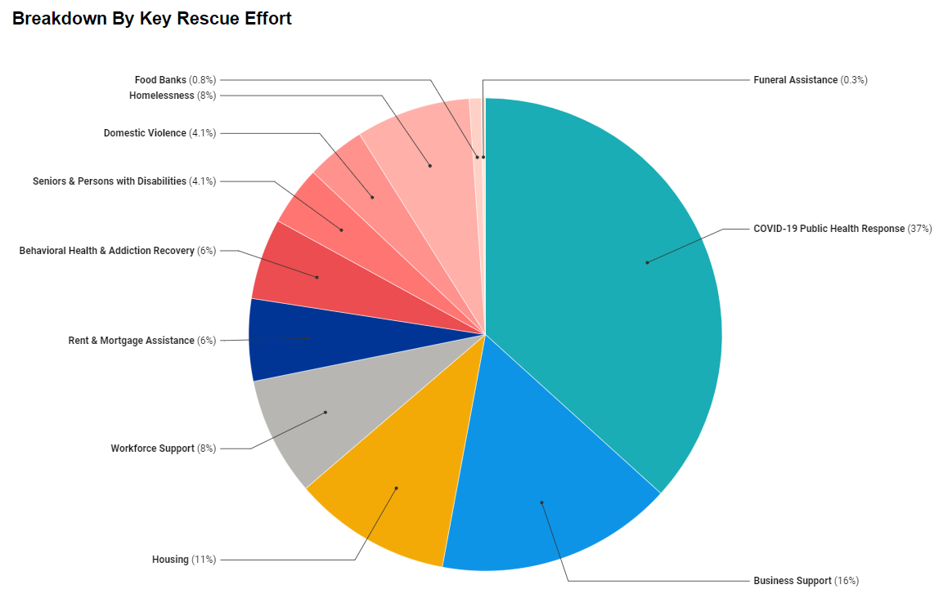
ARPA: An Example
https://www.maricopa.gov/5733/COVID-19-American-Rescue-Plan-Act-Funds
Maricopa County $435M
Notes:
FY2020 SEFA was only $250M
The $435M appears to just be the 1st half. Treasury website says a total of $871M was allocated.
Total ARPA – CSLFRF Funding is $350B

Slide 7
Coronavirus Relief Fund (CRF) 21.019
Authorized under the CARES Act
Fairly broad eligible uses:
To provide direct payments to state, territorial, tribal and other local governments to cover:
Necessary expenditures incurred due to the public health emergency with respect to COVID-19
Costs that were not accounted for in the governments’ most recently approved budget as of March 27, 2020
Costs that were incurred during the period that begins on March 1, 2020 and ends on December 30, 2021

Slide 8
Emergency Rental Assistance Program (ERAP) 21.023
Provides grantees with funding available to assist households that are unable to pay rent or utilities.
For the most up to date guidance, visit the Treasury’s ERA website:
https://home.treasury.gov/policy-issues/coronavirus/assistance-for-state-local-and-tribal-governments/emergency-rental-assistance-program
Much of this funding was passed through to local nonprofit organizations.

Slide 9
Emergency Rental Assistance - Details
CRRSA funded $25B, and ARPA added an additional $21B
ERA1 funds expire on September 30, 2022
ERA2 funds expire on September 30, 2025
Payments are made directly to states, US territories and local governments with more than 200,000 residents.

Slide 10
Coronavirus State and Local Fiscal Recovery Funds (CSLFRF) 21.027
State and local governments are direct recipients (even nonentitlement units of local government are direct recipients).
Fairly broad eligible uses:
Respond to public health emergency due to COVID-19 or its negative economic impact including assistance to households, small businesses, and NFPs, or aid to impacted industries such as tourism, travel and hospitality
Premium pay to eligible workers
Provision of government services to the extent of the reduction in revenue due to COVID-19
To make necessary investments in water, sewer, or broadband infrastructure

Slide 11
CSLFRF - Timeline
March 11, 2021
American Rescue Plan signed
Established the CSLFRF program
May 17, 2021
Treasury’s Interim Final Rule Effective
Nov 15, 2021
Compliance and Reporting Guidance Issued
May 2021
50% of Funds distributed to local governments
May 2022
Remaining 50% of funds to be distributed to local governments
January 2022
Final Rule Released

Slide 12
CSLFRF – Revenue Replacement
Revenue Loss:
Not an eligible use; instead, recipients calculate based on formula to determine the limit for the amount of CSLFRF funds that can be used for the “provision of government services”.
Revenue replacement calculations for expenditures covered under Treasury’s Interim Final Rule are not subject to audit for FY21
SEFA reporting for this program is NOT the result of the revenue loss calculation, but rather aggregate expenditures for all four eligible use categories
Notes:
Auditors should test compliance with the requirements that existed at the time of expenditure.

Slide 13
CSLFRF – Resources
The following resources are available from the Treasury:
https://home.treasury.gov/policy-issues/coronavirus/assistance-for-state-local-and-tribal-governments/state-and-local-fiscal-recovery-funds
Interim Final Rule – May 2021
Interim Final Rule FAQs
Compliance and Reporting Guidance – Nov 15, 2021
Final Rule – Released January 6, 2022
Effective April1, 2022
Notes:
Auditors should test compliance with the requirements that existed at the time of expenditure.

Slide 14
Key Changes between the Interim Final Rule and Final Rule
Broader flexibility and greater simplicity
Offers a standard allowance for revenue loss of $10M, allowing recipients to select between a standard amount of revenue loss or complete a full revenue loss calculation.
Clarifies that recipients can use funds for capital expenditures such as certain affordable housing, childcare facilities, schools, hospitals, and other projects consistent with final rule requirements.
Provides more streamlined options to provide premium pay
Significantly broadens eligible broadband infrastructure investments
Notes:
Final rule clarifies that recipients can take advantage of flexibilities in the Final Rule now, even ahead of the effective date.

Slide 15
Impact on Single Audits

Slide 16
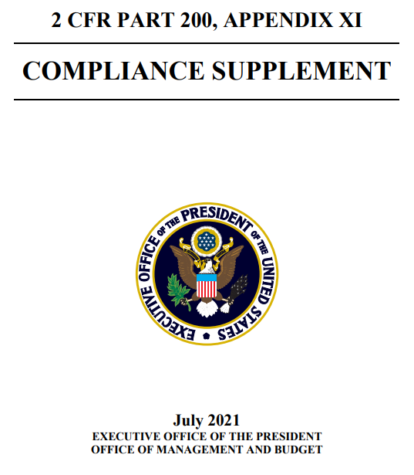
OMB Compliance Supplement
Drives audit procedures related to the federal grants
Publicly available resource
Typically released between May – August for preliminary fieldwork
2021 Compliance Supplement was released in August 2021

Slide 17
Compliance Supplement Status
2021 Compliance Supplement
Issued on August 12, 2021
Addendum #1
Issued on December 3, 2021
Added/Updated 2 programs to the Supplement
New program was Coronavirus State and Local Fiscal Recovery Funds

Slide 18
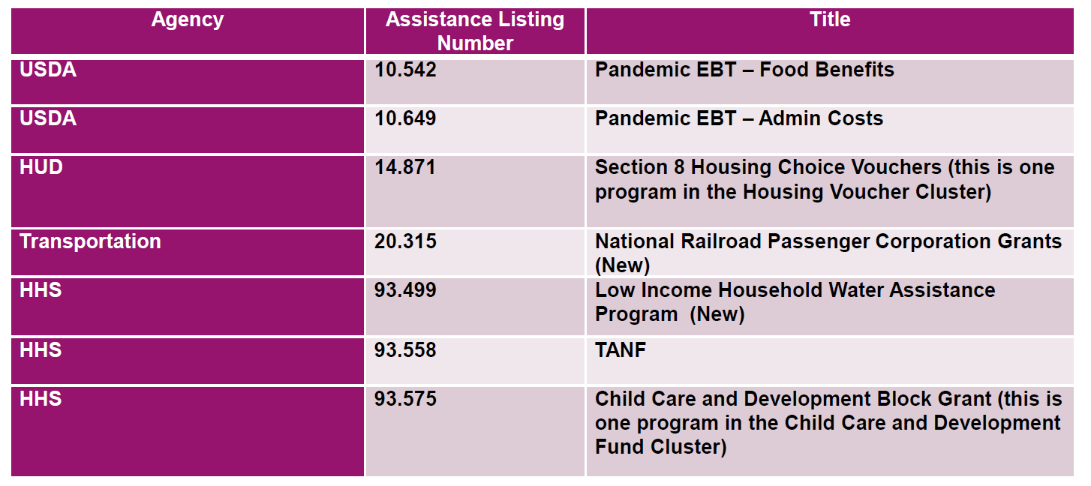
Compliance Supplement Status
Addendum #2 – Expected Issuance January 2022
Programs expected to be included in Addendum #2

Slide 19
2022 Compliance Supplement Status
Striving for issuance by 4/30/2022
The AICPA’s Governmental Audit Quality Center has already begun reviewing draft programs.
At least 4 new programs and approximately 35 existing programs with significant change expected
An addendum may be needed for the 2022 Supplement due to new programs established by the Infrastructure Investment and Jobs Act.

Slide 20
High Risk Program Guidance
All new ARPA programs are considered “higher risk”
In addition, several programs are also required to be considered high risk according to the 2021 compliance supplement.
RESULT: Auditors may need to audit more major federal programs than normal.

Slide 21
Other COVID Implications on Single Audits
Type A threshold may be higher than $750,000 for first time
Programs with expenditures may not be included in the initial supplement.
Work that was previously done as summer work could be pushed back. March 31 filings could be delayed due to backlog of work.
Some entities may be issuing financial statements separately from the Single Audit resulting in dual dated reports.
Notes:
If you will remember, last fall, the OMB issued guidance that stated auditors could issue reports for COVID-19 programs not included in the supplement using Part 7 until the date that further guidance (an addendum) was issued. This could likely be the case again this year.

Slide 22
Audit Extensions
Not linked to receipt of COVID funding
OMB Memorandum M-21-20 (March 19, 2021) allows recipients/subrecipients a 6-month extension
Applicable for fiscal year ends through June 30, 2021
Still can be considered low-risk auditee
No further action by awarding agencies is required to enact this extension
Recipients/subrecipients not required to seek approval
Recipients/subrecipients should maintain documentation of the reason for the delayed filing.

Slide 23
Impact on Compliance and Accuracy of SEFA

Slide 24
New Reporting Requirement
FY 20 a new reporting requirement is being added that will need to be tested for all COVID-19 programs in the addendum.
This will be extended to ALL programs for audits of fiscal years ending after 9/30/20, regardless of COVID monies.
All Direct recipients who make first-tier subawards of $25,000 or more are to report the subaward data through the FFATA Subaward Reporting Systems (also referred to as FSRS) available at USASpending.gov as the publicly available Web site for viewing this information (https://www.usaspending.gov/search)
Notes:
FFATA was not applicable to CRF
Do not know yet if it is applicable to CSLFRF
For cities, could be applicable for HUD and HHS awards made to nonprofits

Slide 25
Subrecipient Monitoring
Entity may not have been a Pass-Through Entity in the past, but may be in that position now with COVID funding.
From an audit perspective:
Subrecipient monitoring may be direct and material for the first time for a grant
Higher risk area
CAUTION: If you are passing funds through to other entities- be sure you are familiar with the requirements for subrecipient monitoring
CAUTION: Subrecipient expenditures are required to be reported separately on the SEFA

Slide 26
Subrecipient Monitoring Requirements
The pass-through entity must:
Identify the award and applicable requirements
Clear identification of assistance listing number (formally CFDA No.) on the grant agreement helps the subrecipient clearly account for the grant award as federal and properly report expenditures on their SEFA
Evaluate risk
Prior experience with federal grants, results of previous audits, risks such as new personnel or new systems
Monitor
Review programmatic and financial reports required to pass-through entity
Review results of subrecipient’s Single Audit if applicable
Notes:
Subrecipient Monitoring is applicable to CSLFRF

Slide 27
SEFA – Timing Issues
Due to the nature in which funds were released, an auditee may have incurred costs prior to receiving an official grant award.
This may result in expenditures reported on the SEFA in a subsequent year.
AICPA – Governmental Audit Quality Center has released Nonauthoritative Guidance as a resource
https://www.aicpa.org/content/dam/aicpa/interestareas/governmentalauditquality/resources/singleaudit/downloadabledocuments/aicpa-gaqc-nonauthoritative-covid-19-scenarios.pdf

Slide 28
Timing Example

Slide 29
Inaccuracies in SEFA to Avoid
Incorrect Assistance Listing Numbers
Underreporting of Grant Expenditures due to missing grants
Underreporting of Grant Expenditures due to SEFA timing issues
Inaccuracies in SEFAs could lead to the need to reissue the Single Audit report in cases where the proper major federal programs were not tested or the proper amount of coverage was not obtained.
Notes:
For some grants, even if they are reported as state or local, it is a wise idea to obtain the grant agreement to confirm.
Also, consider confirming with pass through entity whether or not the grant expenditures will be reported on their own SEFA.
If reissued – there will most certainly be a corresponding finding reported.

Slide 30
Tips for Preparing an Accurate SEFA
Important to get copies of all significant grant agreements in one central location to check for:
Federal vs. local determinations
Information needed to accurately report information on SEFA (Assistance Listing #, Grant award #, COVID?)
Increased communication with departments receiving grants will be really important.

Slide 31
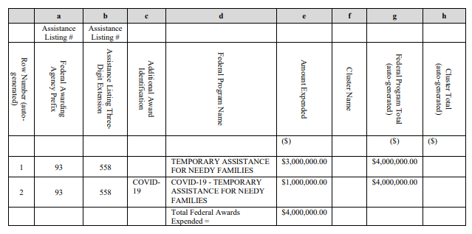
Reporting COVID Grants on SEFA
COVID grants are required to specifically identified as such on the SEFA:
Must say “COVID-19” prior to the grant name in each instance.

Slide 32
Start Preparing for the Fiscal Year 2022 Single Audit Early!
Obtain copies of grant agreements
Consider preparing an interim SEFA that gets updated monthly rather than waiting until year end
Communicate with departments to find out what grants they are anticipating

Slide 33
Contact Information:
Jill A. Shaw, CPA
623-237-7951
jill.shaw@hm.cpa

